Slide 1
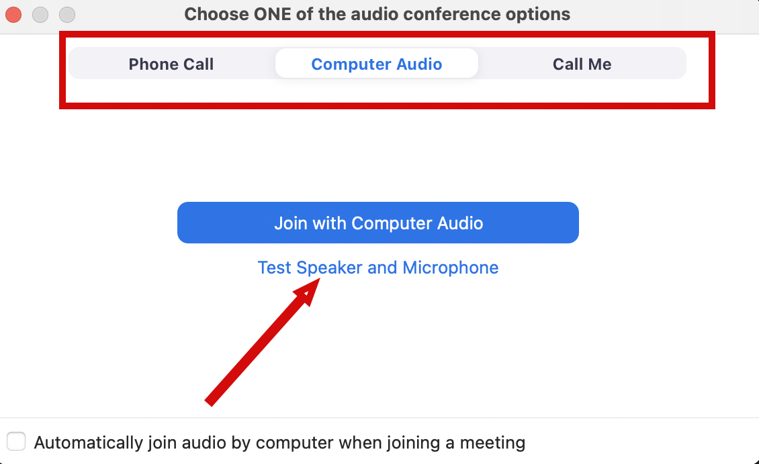

Audio Connection and Chat Zoom
You will not hear any sound until the webinar starts.
Connect Audio
When you join Zoom, the Join Audio preferences box pops-up (Phone Call, Computer Audio, or Call Me)
Choose an option that works best for you
Join using that option
Use Test Speakers and Microphone option to optimize your webinar experience
Chat
Please send your chat to Everyone to make sure the monitor sees your question

Slide 2
Python for Data Science: What to Learn and Why
Cindy Sheffield, NIH Library
Data Services

Slide 3
Training Objectives
Why learn Python?
What to know about reading, writing and running Python code?
Popular IDEs for reading, writing and running Python code:
Google Colab
Spyder
Jupyter Notebook
Jupyter Lab

Slide 4
Why Learn Python?

Slide 5
Why Learn Python?
User friendly - easy to read and easy to learn.
Efficient - facilitates data management, data analysis, process documentation, and visualizations via an ecosystem of libraries.
Productivity – clear syntax, object-oriented design, and code reusability enable developers to write and adapt code efficiently.
Dynamic – Design cycles tend to be short as code can be written and tested
Open Source – Python software and its IDEs are distributed freely for most part. There are inexpensive IDEs. Cost is not a barrier to learning. It simply takes time and effort.

Slide 6
Research Development
Hypothesis
Mark Up Description + Code to Process Data
Results in Context
Easier to Document and Share
Adjustments to Process or Data

Slide 7
What you need to know about reading, writing, and running Python?

Slide 8
What you need to know to read/write/run Python?
Syntax
Variables
Functions
Data Types
Conditionals
Libraries

Slide 9







Syntax

Slide 10
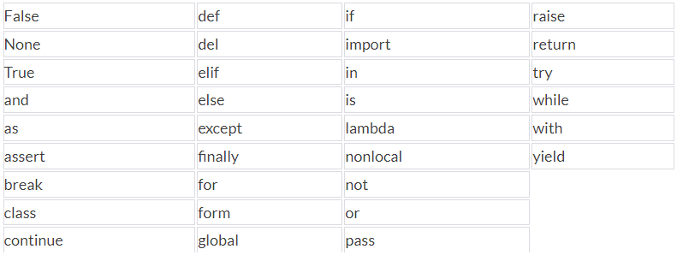
Syntax: Reserve Words
https://flexiple.com/python/python-reserved-words/#section1

Slide 11




Variables
a = “A string of characters”
myfile = “/myfile.csv”

Slide 12
Functions
greet(“New Python Coders”)
def greet (named):
print(“Hello “ + named + ” !”)
Hello New Python Coders!
In this example ‘greet’ is the Function name and ‘named’ is the Parameter variable, the function headers always begins with ’def’ and ends with a colon.
Python Built-in Functions
https://www.pythoncheatsheet.org/cheatsheet/built-in-functions

Slide 13
Data Types
Tuples – Sequence Type, parentheses
MyTuple = (parentheses, exponents, multiplication/division, addition/subtraction)
Lists – Sequence Type, square brackets
names = [“Annie”, “Betty”, “Cindy”]
cities = [“Albany”, “Baltimore”, “Cincinnati”]
items = [“apples”, “bananas”, “cantaloupe”]
Dictionaries – Mapping Type, squiggly brackets
MyDictionary = {“names”: “Annie”, “items”: “apples”}

Slide 14
Conditionals
Loops
If Statements
fruit_list=['apples', 'bananas', 'cantaloupe']
for i in range(0,3):
print(fruit_list[i])
apples
bananas
cantaloupe
x = 4; y =6
if x < y:
print(x, ‘is less than’, y)
else:
print(x, ‘is not less than’, y)
4 is less than 6

Slide 15
Libraries
Pandas Library
import pandas as pd
function | library | assign | short for pandas
Enables code:
df_alphasong = pd.read_csv(“/alphasong.csv”)
NAMES | CITIES | ITEMS
Annie | Albany | Apples
Betty | Baltimore | Bananas
Cindy | Cincinnati | cantaloupe
Example data frame
alphasong.csv =

Slide 16
Libraries
Python Libraries can be found at PyPI.org.
PyPI is the Python Package Index: a repository of software for Python programming
Statistical Analysis and Visualizations Libraries include:
Pandas (data frames)
NumPy (math functions for arrays)
Statsmodels
TensorFlow
Scikit-learning
Mathplotlib (np + Visualizations)
Plotly
Seaborn (Visualizations)
import pandas as pd
import numpy as np
import seaborn as sb

Slide 17
What you need to know to read/write/run Python?
Syntax
Variables
Functions
Data types
Conditionals
Libraries

Slide 18
IDE for Python Code

Slide 19

Popular IDEs for Python
Popular IDEs for reading, writing and running Python code:
Google Colab
Spyder
Jupyter Notebook
JupyterLab

Slide 20
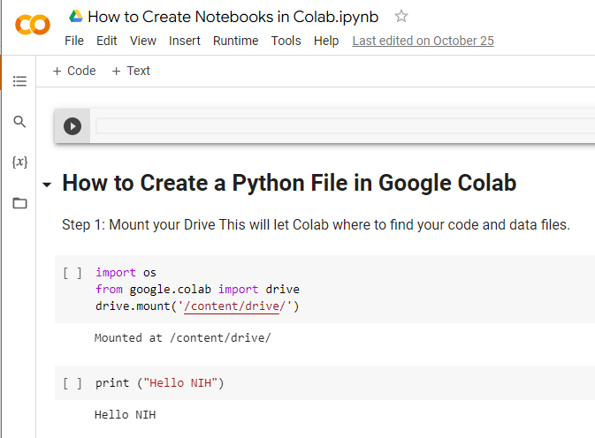
Google Colab
https://colab.research.google.com/notebooks/welcome.ipynb

Slide 21
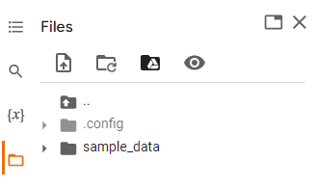
Google Colaboratory Setup
Create a new Google Account for Colab.
Go: https://colab.research.google.com/notebooks/welcome.ipynb
Click on Getting Started for a quick overview of Colab
Use File / Notebook to find online guides.
Connect to files Google Drive by either:
Type text below or select Drive icon under Files
import os
from google.colab import drive
drive.mount('/content/drive/')

Slide 22
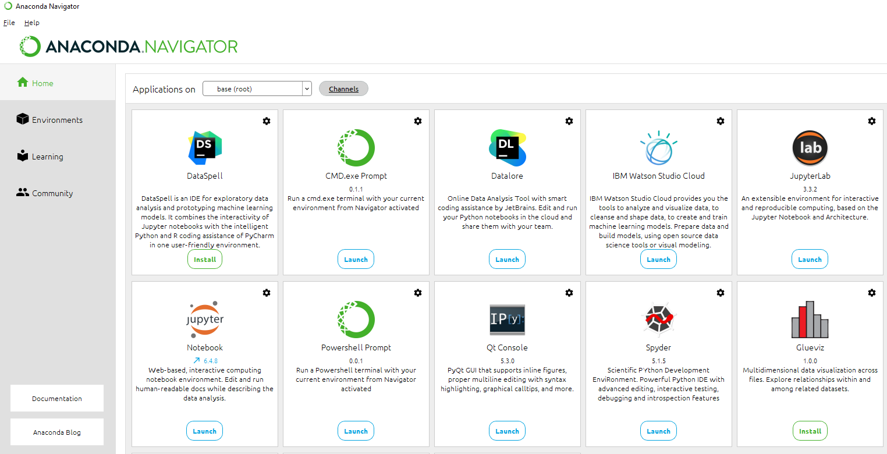
Anaconda
Jupyter Notebook
Spyder
JupyterLab

Slide 23
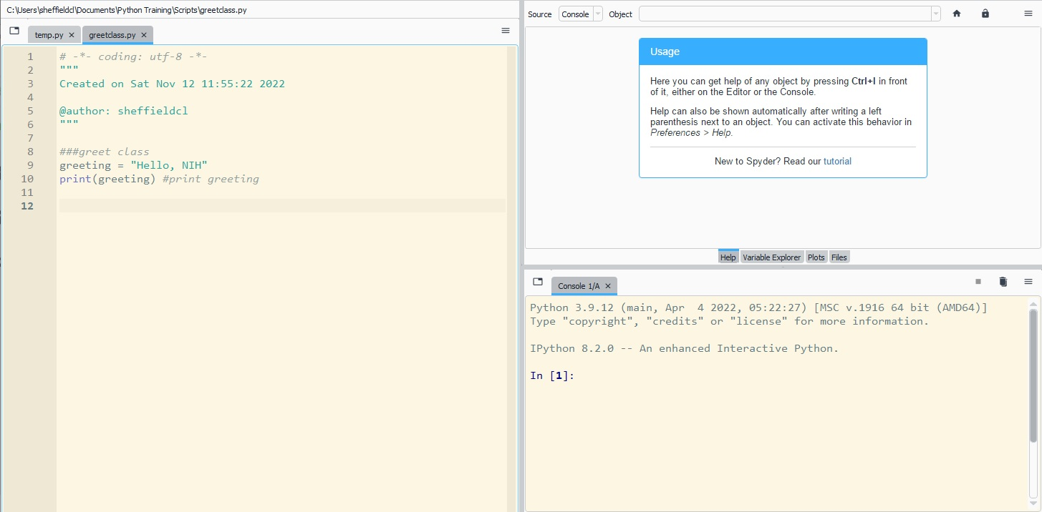
Spyder
Install Anaconda
Launch Spyder
File/Open/open script
OR
File/Create/create new
Ctrl-L will give you help.
There is a tutorial.
https://docs.spyder-ide.org/current/quickstart.html

Slide 24
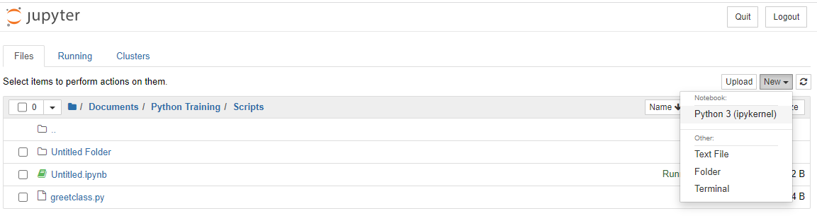
Jupyter Notebook
Open Anaconda, Launch Jupyter notebook Select ‘New’ Select ‘Python 3 (ipykernal) Save “filename”
1
2

Slide 25
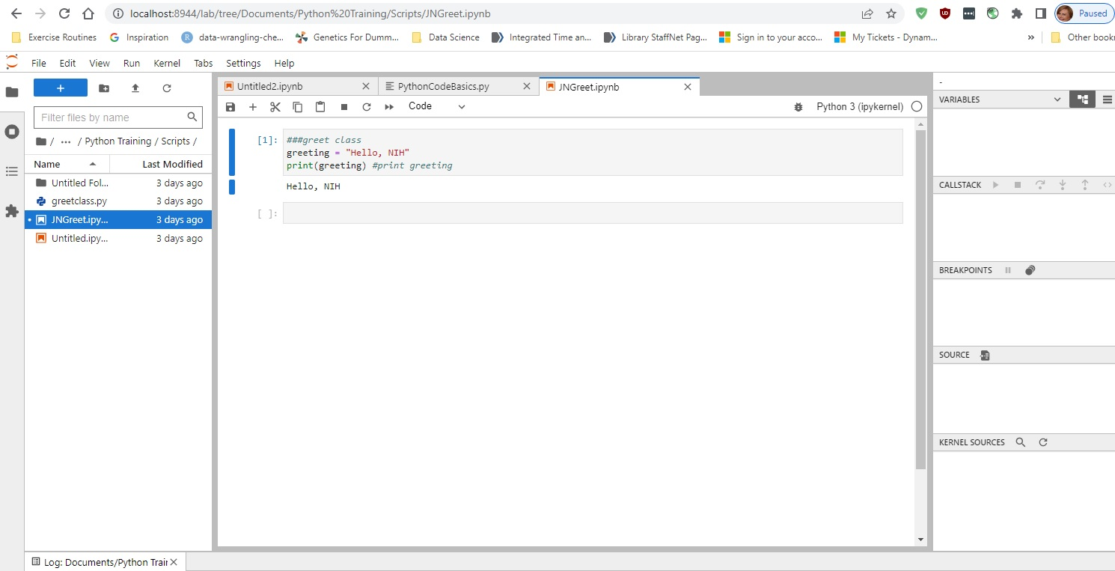
Jupyter Laboratory
Install Anaconda
Launch: JupyterLab
File/Open/open script
OR
File/Create/
create new

Slide 26
IDE Attributes
Console: - Where code runs
Project Files: - Code and data files
Variables: - One Identifier to assign something to a variable
Data View: - View of the data frame being processed
Plots: - View of the graph being generated
History: - Code history processes in active memory
Autocomplete: - Python feature to help with coding
Debugging: - Python feature to help with finding errors
Markdown: - Code to add text around the code

Slide 27
Google Colab IDE Attributes
Console: Within Colab there isn’t a separate console, but the instead the active code and related error messages occur within each cell.
Project Files: To see where your Notebook is stored use the folder icon on the left to navigate to your MyDrive / Colab Notebooks. “PythonCodeBascis”.
Variables: (Show current variables) We have a notebook here with code, but none of this code is NOT in our active memory, because the only code that has been run is the cell to initialize our PythonCodeBasics notebook and the little bit of code we just recreated. Let’s run the code in a few more of these cells.
Data View: Simply double left click on the data file to view the table on the right side of the Colab screen.
Libraries: All of the Python libraries are available to Colab so it is a matter of importing each library you want to use and assigning that library to a shortcut or nickname such as import pandas as pd. You will need to have knowledge about the libraries you want to use and why you want to use them.
Plots: Once you run the code and import the associated data for plots, the plots will appear directly within Colob. There is also a ‘View output full screen’ feature using the menu to the right.
History: To view the History of code run during a session select the View menu, and then ‘Execute code history’.
Autocomplete: Note the autocomplete feature will try and complete and function such as ‘print’ or argument that appears within your active Variables list.
Debugging: If you have an error in your code, an error message will appear to help with debugging.
Comments and Markdown: Comments can be added using 3 hash marks on any line of code. Markdown text can be added using the + Text tool.

Slide 28
Spyder IDE Attributes
Console: The console is immediately viewable in the lower right pane. If I highlight my first line of code in the script and run it using the F9 key, it will run the code and the results from the code in the Console. If I highlight and run the next line, “2*3” and use the F9 key will give me that code and result as well.
Project Files: We can get to Project Files by using File / Open or Open Recent to find the .py file you choose to use.
Variables: Can be viewed in the upper right pane using the “Variable Explorer” tab. Note each data type will be a different color.
Data View: Using the Files tab in the top right pane, identify your data set, click on it to see the content. If you’d like to see the content in a spreadsheet you can right click on the file and use the dropdown menu to select “Open externally”. It will open in Excel outside of Spyder.
Libraries: Libraries are need for dataframe, calculation and visuals. Import needed libraries.
Plots: Can be viewed in the upper right pane, using the Plots tab.
History: The History can be viewed in the lower right pane, using the History tab.
Autocomplete: Similar to Colab Sypder will autocomplete functions and arguments that are in active memory.
Debugging: There is a Debug menu at on the top menu bar of Spyder
Comments and Markdown: Comments can be noted using triple single quotes for large areas of text and the # sign for line comments. Markdown is not an option in Spyder.

Slide 29
Jupyter Notebooks IDE Attributes
Console: The format is very similar to Google Colab, with the code and related error messages being generated in the main screen.
Project Files: Can be open via the File dropdown menu. New project files can be created using that option from the dropdown menu.
Variables: With pandas running, in one of the empty cells run “%whos”
Data View: To view data frames in one of the empty cells use the function display(<data frame name>) Example: display(iris) may need to specify file path
Libraries: Need to be familiar with libraries and import them and assign them short names.
Plots: Plots will appear directly in the cells with the code to generate them.
History: In one of the empty cells run “%history”
Autocomplete: Start typing the first few letters of a function or argument and then hit the Tab key, and Jupyter Notebooks will autocomplete the rest of the code.
Debugging: Error messages usually show within the cell. Alt + Shift + Enter is another way to see error codes.
Comments and Markdown: Comments can be created with quotes and # signs. Markdown is available from dropdown menu immediately under the Widgets option on the top menu bar.

Slide 30
Jupyter Labs IDE Attributes
Jupyter Labs is very similar to Jupyter Notebooks.
The main difference is that you can have multiple tabs open with notebooks or .csv files in this IDE. Multiple consoles can be run as well. This is helpful if you are trying to run different sets of code with different applications.

Slide 31
Test Your Knowledge
Log on to one of the IDEs.
Type the follow code:
name = “#” #Add your name
str = “ thinks Python is ” #note spaces before and after clause!
descpt = “#” #Add descriptor to indicate how you feel about Python
print (name + str +descpt)

Slide 32
Learning Resources
FAES Classes
Coursera
Online tutorials
Stackify - 30+ Tutorials to Learn Python
FreeCodeCamp - Code Class for Beginners
Harvard – Free Python Course
Coursera – Free and Paid Python Courses
LearnPython – Free Interactive Python Tutorials
BestColleges – 10 Places to Learn Python for Free
Books
Learning Python, O’Reilly
Head First Python, Paul Barry
Troubleshoot / Debug
Python - Help
How to Debug Your Python Code
Python - Debugging and Profiling
Python Debugger – Python pdb

Slide 33
References
BioPython: freely available Python tools for computational molecular biology and bioinformatics https://academic.oup.com/bioinformatics/article/25/11/1422/330687?login=true
Design of Experiments (DOE) with python https://medium.com/mlearning-ai/design-of-experiments-doe-with-python-be88f5c013f5
Introduction to Jupyter Notebook | Jupyter Notebook Tutorial https://youtu.be/1A7tea9LSEk
JupyterLab Tutorial for Everyone https://youtu.be/mspsHIk_qUQ

Slide 34

We Can Help
Classes on a variety of data-related topics, including:
Data management
Data visualization
Data analysis
R and RStudio
Computers which offers a suite of tools for data analysis, processing, and visualization

Slide 35
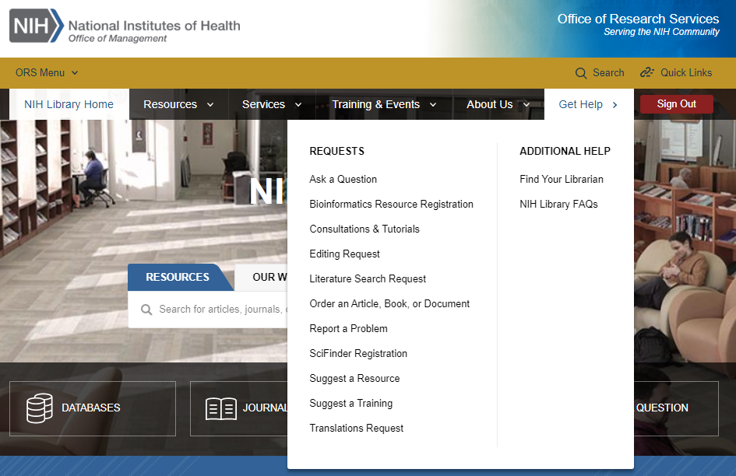
Contact Us for Ongoing Support
Cynthia Sheffield
Data Services Librarian
301-803-8912
cynthia.sheffield@nih.gov
NIH Library Help Desk (301) 496-1080
Ask a Question: https://www.nihlibrary.nih.gov/get-help/ask-question
Request a Tutorial: https://www.nihlibrary.nih.gov/get-help/consultations-tutorials
Sign up for Additional Classes: https://www.nihlibrary.nih.gov/training/calendar

